Slide 1
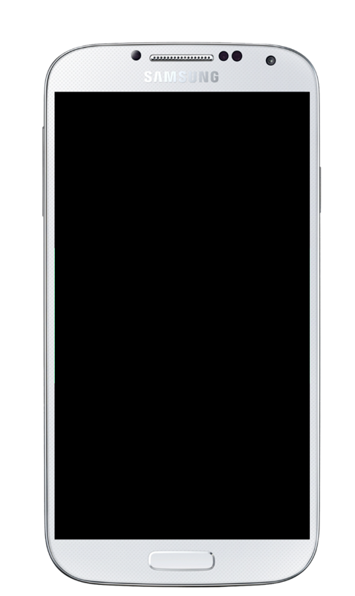

Slide 2
Samsung Galaxy S4 iPhone 6s
At least 2 screenshots are required overall. Max 8 screenshots per type.
Screenshot requirements are:
Min length for any side: 320px.
Max length for any side: 3840px.
How to use this template:
Do not resize the blue box. The box is your work area and has been sized to optimized size. You can however change the color (including white) or add a fill. (Dimension: 22.59 x 12.7 cm)
Feel free to resize, crop or remove the device to fit your needs. Ensure that the crop lines do not exceed the space of the box (Otherwise your image will save at an incorrect dimension)
Import your app screenshot as an image as lay it over the device. Resize to fit.
To save as an image select all the elements and left click “Save as image”. You can save as a .jpeg or .png.

